Slide 1
Digital Resources one
Butterfly Ten Frame

Slide 2
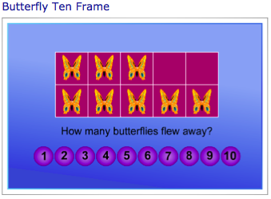
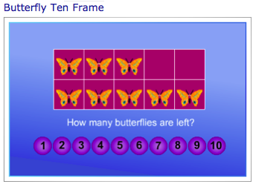
Purpose of game The purpose of the game is to reinforce and practice combining and partitioning concepts. The game involves joining or separating collections of objects. By starting with a ‘full frame’ and taking a group or groups of objects away, students can practice number combinations to ten.

Slide 3
Advantages of the resources
The concept and purpose of the game is relevant and appropriate for lower primary grades that are at the symbolic stage of the language model (Jamieson-Proctor, 2010). The ‘Butterfly Ten Frame’ game has been developed by the New South Wales Department of Education and Training (2009), Which makes it a reliable resources that would be allowed to be accessed through most school computers. The ‘Count Me in too’ website also provides teachers and students with a wide variety of curriculum subject games and free printable resources across many year levels.
Reliable resources Supported by the NSW Department of Education and Training

Slide 4
Disadvantages of the resource
However, the game provides no opportunity for students to reflect on mistakes and offers no reward for successfully completing the game. Teachers would need to ensure that students are not simply guessing until they find the correct answer as there is no record of correct and incorrect answers. The patterning of the game is consistent, but this may result in limited attention span of students.
Students receive no reward for finishing the game

Slide 5
The ‘Butterfly Ten Frame’ game (2009) can be found at:
http://www.curriculumsupport.education.nsw.gov.au/countmein/teachers_teaching_ideas_-_butterfly_ten_frame.html

