Slide 1
Concrete Resource

Slide 2
About Super Teacher Work Sheets
Super Teacher Work Sheets is a free online resources that allows parents and teachers to access free printable worksheets from years prep- 7 across most curriculum areas. Each worksheet comes with an answer page, and a selected few also have a student progress template. The work sheets are of high-quality, with accurate information.
Advantages:
The Web site is easy to access and easy to move through. Finding resources is simple and effective. All documents have been developed by educators, thus they have been tested by real teachers and students before they are placed on the web site.
Disadvantages: The site dose not include explanations as to the real-world or curriculum link to the resources, thus teachers and parents would need to ensure that what resources they choose to use are appropriate for the student.

Slide 3
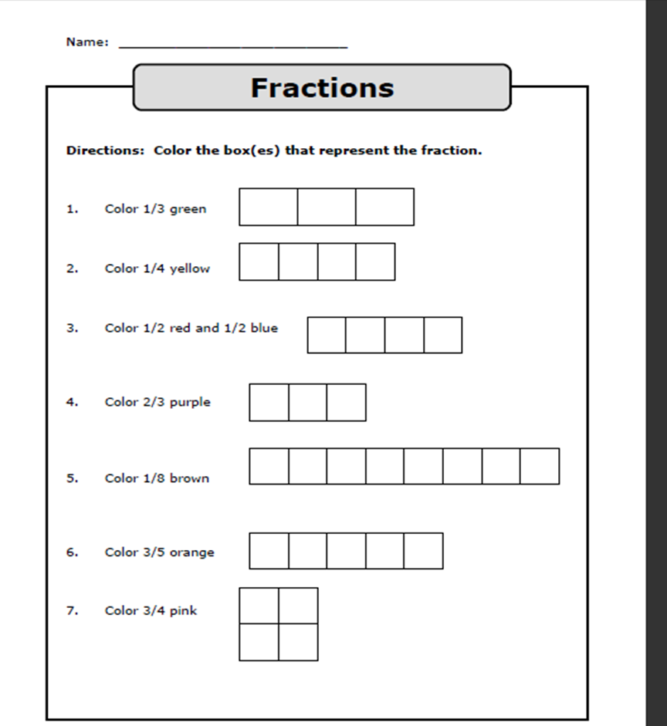
The Particular work sheet that I found as a useful resources for practicing and reinforcing fraction is ‘Fraction colouring (basic)’.
It allows students to practice recognising the symbolic representation of fractions. It also allows students to reflect on introductory lessons to fractions, thus students further develop their concept of fractions at a symbolic stage.

Slide 4
Reference:
Jameson-Proctor, R (2011). Topic 7- Fraction Concepts, Common fractions and Operations on CF’s. [Lecture recording]. University of Southern Queensland, Toowoomba. Recoding retrieved from: https://mediarep-prd-vip.usq.edu.au/b-repository/2011/2/EDX/EDX1280/Lecture_7_Common_Fraction_Part_1/Lecture_7_Common_Fraction_Part_1_-_Flash_(Original_Size)_-_20110829_11.16.22AM.html
Super Teacher Work Sheets. (2011). Retrieved August 27, 2011. From http://www.superteacherworksheets.com/fractions-basic.html

