Slide 1
Science in 3R The Plains College 2012
Mrs Kathryn Reid
Notes:
EDX2260 Teaching Science for Understanding by Kathryn Reid 0061000325
Good afternoon parents. I will start by welcoming all of you to this information event, my name is Kate Reid and I will be teaching year three in the coming year.
I would like to take this opportunity to let you know what students will be learning about this year in science class, as well as why they are learning it.
national curriculum
the benefits you child gains from participating in science
specific examples of the activities we as a class will be doing
I want all students to get excited about science this year. Research shows that when parents take an interest in what their children do in school, it has a really positive effect on how the child sees school (Kiernan & Mensah, 2010). So I would love all of you to really get behind your child- please feel free to come and join us in the classroom or join us on excursions.
I know from previous years, the children love to share what they are doing with their parents. The whole class really, really love it when the mums and dads join in with their activities!

Slide 2
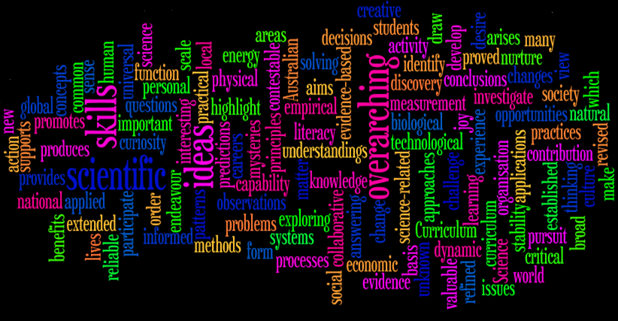
The curriculum rationale: Australian Curriculum
Notes:
So who decides what children learn?
In the new year, we will be changing to the new Australian Curriculum.
The National Curriculum aims to give every child, no matter where they live the same educational opportunities.
For those of you who are interested, I have a handout (Australian Curriculum Information Sheet, 2011) detailing the new curriculum available on the stand by the door, please feel free to take one {point to where handouts are} at the end of the evening.
The rationale given by ACARA, the Australian Curriculum Assessment and Reporting Agency is that in the study of science, student’s science have the opportunity to:
answer interesting and important questions about the biological, physical and technological world
gain a reliable basis for action in our personal, social and economic lives
develop an understanding of important science concepts and processes, the practices used to develop scientific knowledge, of science’s contribution to our culture and society, and its applications in our lives
experience the joy of scientific discovery and nurture their natural curiosity about the world around them
The overarching ideas are patterns, order and organisation; form and function; stability and change; systems; scale and measurement; and matter and energy (ACARA, 2011a).
The new curriculum is quite different to previous curriculums, it focuses on quality learning, and aims students gain a deep understanding of a fewer areas, rather than students learning a little bit of everything.
Now some parents may find this an interesting prospect; as in “you mean you going to teach my child less?” but the reasoning is, if children really understand what they are learning, and it has meaning for them, they are able to apply their knowledge and understanding to other areas, something which is much more difficult to do with a bunch of memorised facts!
I created this word cloud using the actual rationale from the ACARA site, which gives you quite an interesting perspective of the document.

Slide 3
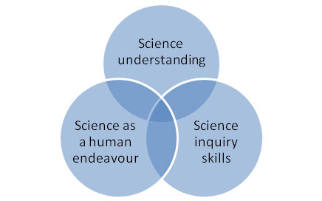
.
Curriculum Structure
➲ Science Understanding
➲ Science as a Human Endeavour
➲ Science Inquiry Skills
Notes:
In the Australian Curriculum, Science is comprised of three interrelated strands:
As they work through each of the three strands, students develop a scientific view of the world (ACARA, 2010).
When we say ‘science understanding’ we mean as opposed to ‘science facts.’ students should be able to:
make predictions about what they think will happen and explain why certain things happen, by drawing on their knowledge of science.
students to be able to use the knowledge in new situations (ACARA, 2010).
‘Science as a human endeavour’
science has developed as a unique way of knowing and doing
the role of science in decision making and problem solving
science is influenced our needs and priorities as a society (ACARA, 2010).
‘Science inquiry skills’
being able to think of good questions to ask,
planning and carrying out investigations,
figuring out what the results of an investigation mean
being able to tell someone else what you have found out.
think about a claim and figure out whether it is true or not, using their knowledge of science and scientific methods of investigation (ACARA, 2010).
As you can see, each of these areas cross over into the others, and we teach so as to build on previous knowledge.
{give example} the students might practice their inquiry skills while learning about earth and space science as they look at how humans have developed the technology for space travel, building on the students knowledge of technology in history (ACARA, 2010).

Slide 4
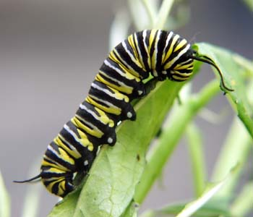
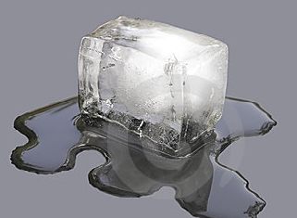
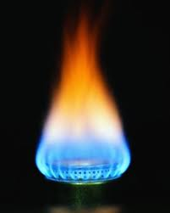
Science Understanding
(sub strands)
Biological Sciences: Living things can be grouped on the basis of observable features and can be distinguished from non-living things
Chemical Sciences: A change of state between solid and liquid can be caused by adding or removing heat
Earth and Space Sciences: Earth’s rotation on its axis causes regular changes, including night and day
Physical Sciences: Heat can be produced in many ways and can move from one object to another
Notes:
There are sub strands within each of the strands of ‘Science Understanding’
Biological Science:
recognising characteristics of living things such as growing, moving, sensitivity and reproducing
recognising the range of different living things
sorting living and non-living things based on characteristics
exploring differences between living, once living and products of living things
Chemical Science:
investigating how liquids and solids respond to changes in temperature, for example water changing to ice, or melting chocolate
exploring how changes from solid to liquid and liquid to solid can help us recycle materials
predicting the effect of heat on different materials
Physical Science
describing how heat can be produced such as through friction or motion, electricity or chemically (burning)
identifying changes that occur in everyday situations due to heating and cooling
exploring how heat can be transferred through conduction
recognising that we can feel heat and measure its effects using a thermometer (ACARA, 2010)
Earth and Space science
recognising the sun as a source of light
constructing sundials and investigating how they work
describing timescales for the rotation of the Earth
modelling the relative sizes and movement of the sun, Earth and moon (ACARA, 2010)

Slide 5
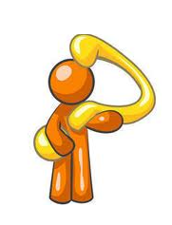
Inquiry Skills:
Questioning and predicting
Planning and conducting
Processing and analysing data and information
Evaluating
Communicating
Nature and development of science: Science involves making predictions and describing patterns and relationships
Use and influence of science: Science knowledge helps people to understand the effect of their actions
Science as a Human Endeavour
& Science Inquiry Skills
(sub strands)
Notes:
In year three, Science as a human endeavour strands are {read from blue boxes on screen}
With sub strands:
making predictions about change and events in our environment
researching how knowledge of astronomy has been used by some Aboriginal and Torres Strait Islander people
considering how posing questions helps us plan for the future
And
considering how heating affects materials used in everyday life
investigating how science helps people such as nurses, doctors, dentists, mechanics and gardeners
considering how materials including solids and liquids affect the environment in different ways
deciding what characteristics make a material a pollutant
researching Aboriginal and Torres Strait Islander people’s knowledge of the local natural environment, such as the characteristics of plants and animals
While working through the strands of science curriculum, students will develop scientific inquiry skills {read list from screen}
So far, we have covered the science curriculum, and you may be wondering “why is this stuff important?”

Slide 6
So why learn Science?
➲ To be scientifically literate
➲ To make informed decisions
➲ To support literacy and numeracy
➲ To explain the world
Notes:
To put it simply, science is important for many reasons, not just for people working in science based careers, but to everyone!
The first and foremost reason to learn science is to be scientifically literate.
It is important to have an understanding of scientific concepts, and be able to apply them in different situations. An understanding of the purposes and ways evidence is collected by the scientific community allows us to decide if evidence is believable (EDC2260, 2011).
Which means we can make informed decisions.
When we:
decide which foods to buy from the supermarket,
which car to drive
make medical decision for ourselves or loved ones
we are relying on our scientific knowledge.
A quote by Haigh, “That a large number of people accept without question, any old codswallop that someone cares to tell them is one of the greatest social problems of our time.” (Haigh, in Qualter et 01. 1990, p. 11).
Science crosses over into other academic areas, two in particular are literacy and numeracy. When students are engaged in thinking and working scientifically, they use and develop a whole range of range of literacy skills (Skamp, 2007).
{give example} imagine a child who avoids reading or math, when given a task to create for example a robot, is suddenly much more interested, even though the activity involves reading instructions and working out how many parts are needed!
We can understand and explain the world through science and our knowledge can change as new scientific discoveries are made.

Slide 7
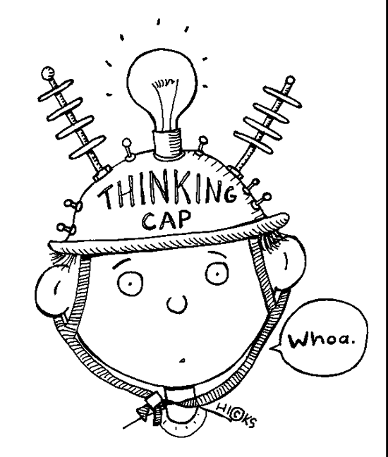
Scientifically literate people
Are interested in and understand the world around them
Are sceptical and questioning of claims made by others about scientific matters
Engage in discourses of and about science
Make informed decisions about the environment and their own health and wellbeing
Are able to identify questions, investigate and draw evidence-based conclusions
Notes:
Scientific literacy is the goal of science education in many countries, including the USA, the UK and Australia (Scamp, 2011).
Being scientifically literate has five components {read from screen}. Basic scientific concepts and understandings help us to make sense of our world, something that is equally relevant for people of all ages and walks of life (Skamp, 2010).
We need our students- the future doctors, policemen, shopkeepers, mums and dads, chemists and tradespeople to be able to think critically- probably the most useful and important skill we can give them- so they can sort through the huge amount of information they will work through over the course of their lives and come to reasonable conclusions (Campbell, 2008).

Slide 8
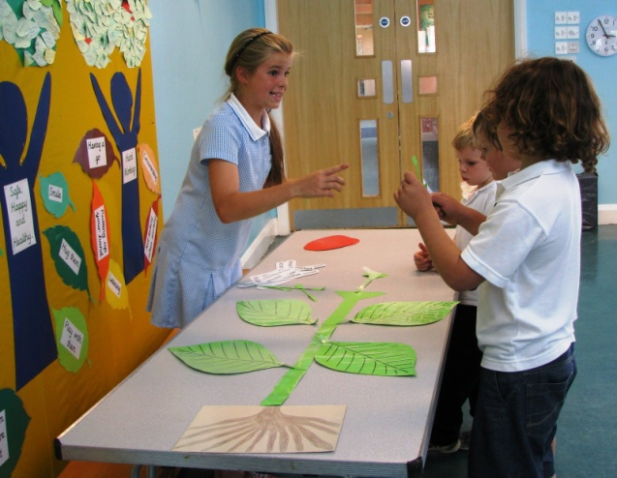
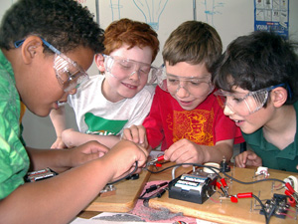
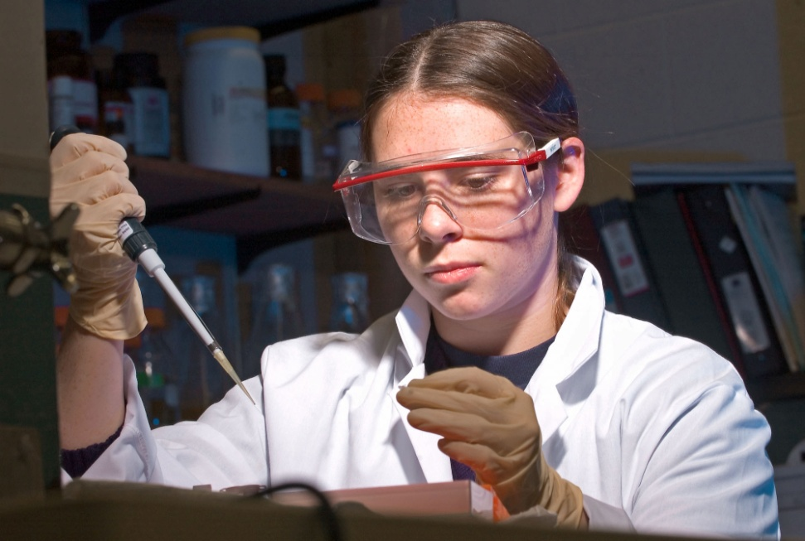
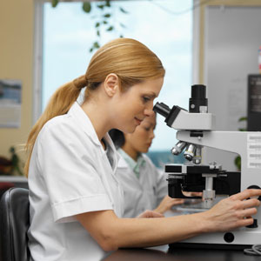
Science as a Human Endeavour
“If people don't do science, then science doesn't get done”
Notes:
What does ‘science as a human endeavour’ mean?
It is people who come up with ideas, develop process and ways of working- people develop scientific understanding. As new discoveries are made, and new ideas are had, science changes.
In class this year, we will consider:
Science involves making predictions and describing patterns and relationships
Science knowledge helps people to understand the effect of their actions (ACARA, 2009)
In science class, students are going to learn what science is, how science is done, so they understand that people who do science are regular people. The last point can be difficult for children, studies (Buldu, 2007) show kids think scientists:
are men with glasses
have beards and strange hair
wear white lab coats
This can present a problem - if they cannot imagine themselves as scientists, they may not pursue science in school or work, even if it is an area that interests them.
If people don't do science, then science doesn't get done (Lawrence, 1980)
I aim for all of my students to be scientifically literate, to see that science is something important and worthwhile, and something that they can do.

Slide 9
Scientific Inquiry
.
Ask a question
Do background research
Analyse your data
Report your results
.
Test hypothesis by doing an experiment
Construct a hypothesis
.
Notes:
Using a scientific method means we can obtain reliable knowledge with a high degree of accuracy. Scientific method establishes the principles that guide scientific research and experimentation, and is practiced within a context of scientific thinking, which is based on three things:
using empirical evidence (evidence that can be seen, heard, touched, tasted, or smelled)
practicing logical reasoning (process of using a rational, systematic series of steps based on sound procedures to arrive at a conclusion)
possessing a sceptical attitude (constant questioning of your beliefs and conclusions)
(Schafersman, 1997)
Every time we conduct an experiment in class, we will use this process, and I will reiterate these six key points.

Slide 10
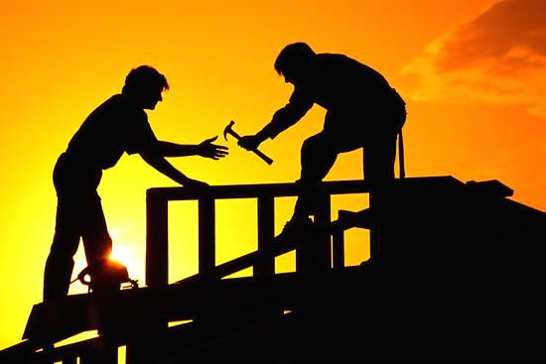
Teaching Science Constructively
Choose the approach
➲ Choose the topic
➲ What does the learner know already?
➲ Supportive classroom environment
➲ How can the students and teacher construct knowledge together?
Notes:
The approach: fits in with pedagogical viewpoint: e.g. Constructivist approach sets the scene, finds out students ideas, selects strategies which would help student learn and ensure students reflect on their ideas.
The topic: all students should have the opportunity to learn physical science at school (Australian Education Council, 1994); learning about how a thermometer works is applicable in everyday life and learning about our place in space and our relationship with the sun exposes students to ideas that can challenge the way they perceive humanity and its place in the universe (Skamp, 1998).
Before I can begin teaching, I need to know (Ausubel, 1968):
What they do know
If they have ‘gaps’ in their knowledge
What if any misconceptions they have
Research (Hewson, Beeth & Thorley, 1998) shows that when certain condition are met, ‘learning will occur more frequently and for more students.’
Create supportive atmosphere for learning:
Value and respect ideas
Encourage students to develop their own ideas
It is ok not to know the answer
Physical environment:
accessible resources for learning
Thinking skills:
reflect on learning
link new ideas to existing/new situations (Skamp, 1998)

Slide 11
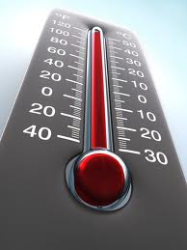
Physical Science
Recognising that we can feel heat and measure its effects
using a thermometer
Notes:
Why learn this?:
when students learn how to measure the effects of heat with a thermometer, they are able to apply this in a variety of real life situations, such as deciding what to pack when going on holiday to cooking the perfect roast chicken or setting their freezer to keep food fresh. Because thermometers are measurement devices, learning how to measure temperature fits in with the overarching ideas in science curriculum ‘scale and measurement’ a skill which promotes the development of a scientific view of the world’
When do we learn this?:
This sub strand will be covered in 4th term, after we have covered the sub strands:
describing how heat can be produced such as through friction or motion, electricity or chemically (burning)
identifying changes that occur in everyday situations due to heating and cooling
exploring how heat can be transferred through conduction
We can use ‘scientific inquiry method’ to investigate heat and temperature.
Ask a question {is boiling the hottest temperature?}
Do background research {experiment with thermometers, measure the temperature of a variety of things}
Construct a hypothesis {100°C is the boiling point for all liquids}
Test/retest hypothesis {boil a variety of liquids}
Analyse data {what was the hottest liquid?}
Report findings {write a report on temprature with diagrams using information from our TWLH chart}

Slide 12
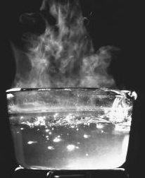
Heat and Temperature
Common misconceptions children
have about heat and temperature
➲ ‘Boiling’ means ‘very hot’
➲ All liquids boil at 100°C and freeze at 0° C
➲ Boiling is the maximum temperature a substance can reach
Notes:
Because children can have misconceptions about heat and temperature (Hapkiewicz, 1992), it is important to find out what if any that have, and use this as a base to work from (Abruscato, 2004).
Before we begin, I would like to engage the children by asking them to tell me what they know about heat and temperature, and we can begin to fill in our TWLH charts.

Slide 13
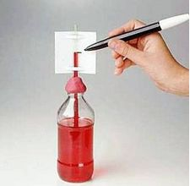
What do students need to know?
➲ A thermometer is a device used to measure temperature
➲ Temperature is measured in Celsius, Fahrenheit, and Kelvin
Temperature does not depend on the size or type of object
Cold and hot are variants on the same continuum
➲ Liquid* expands when it is cooled
and contracts when heated
Activity 1 build thermometer, take measurements
Notes:
In previous unit, we place a bottle if water into the freezer, water level marked, and measure the rise in level as the water cools.
Activity: build a thermometer
Possible questions to consider and discuss:
Is it possible to use what we know about water expanding and contracting with heat to measure the effects of heat? How?
With a clear bottle, water, rubbing alcohol, a straw some food colouring and a piece of blue tack, we can create a thermometer.
In groups, students make a thermometer, and test it
Ensuring each thermometer uses the same sized bottle and had the same amount of liquid, take each thermometer to various places at school- in the bright sun, in the staffroom fridge etc.
Mark on the straw the level of the liquid on each one.
Discuss:
How much did the water move?
Could the students predict the level of the rise based on their observations of the temperature of the thermometers placement?
Activity: Take measurements (use different types of thermometers)
Possible questions to consider and discuss:
Is a big block of ice colder than a small one?
Can students make predictions about the temperature of an object?
If we add a compound (salt or sugar) to boiling water, does it change the temperature of the water?
Provide students with a variety of things to measure the temperature of e.g. Humans (auxiliary temp), drink bottle of water left in schoolbag/out in the sun, air temperature, large/small ice cubes, saucepan of boiling water (safety precautions need to be taken)
Discuss:
Were students able to accurately predict which of the measured objects would be warmer/coolers than others {example-which is warmer, the drink bottle left in the sun, or the human body?}
*Water is a slight exception to this. From 4 degrees C up to 100 degrees C it expands when heated, but when cooled from 4 degrees C to 0 degrees C it also expands, which is why ice floats on water (it is less dense)

Slide 14
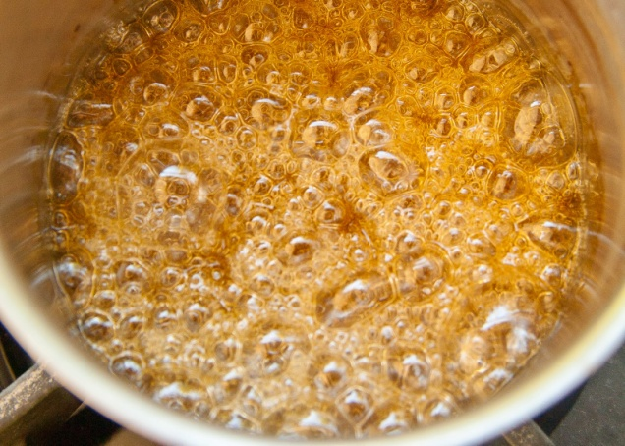
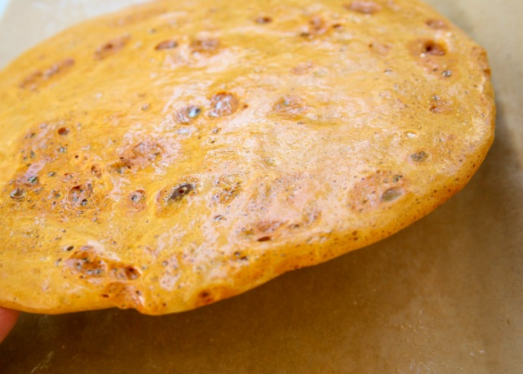
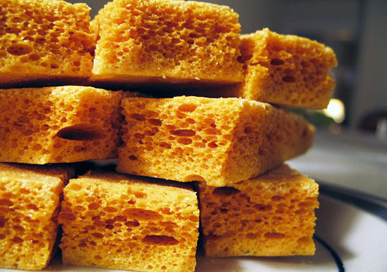
What do students need to know?
➲ Different thermometers are used for specific purposes
➲ The boiling point for sugar water is higher
than that of water
➲ The boiling point of a liquid (a solvent)
will be higher when another compound is added
T
Activity 2 make honeycomb candy
Notes:
Building from the previous learning experiences, students will make use their understanding of thermometers to make honeycomb candy, using recipe from http://www.sallypasleyvargas.com/2011/07/gimme-candy-gimme-ice-cream-gimme-sugar.html
Materials: candy ingredients, sugar thermometer, large pan, stove element, spatula, cookie sheet, baking paper, spray oil
Make candy, following very stringent safety guidelines (closed environment, all materials pre-prepared, large enough pan, students standing back, safety glasses, teacher only to touch hot pan)
Possible questions to consider and discuss:
How is a candy thermometer the same as/different to the other kinds of thermometers we have used?
Link back to previous units on changes that happen when heat is added or taken away, can students predict what will happen to the sugar when we place it into the water
Why is the sugar dissolving and is it a permanent change? {link to curriculum}
Does it matter if we follow the recipes instruction to heat it to 150° or could we chose any ‘hot’ temperature?
Encourage students to watch the candy thermometer throughout the experience
Can students tell the temperature of the candy mixture, by reading the thermometer?

Slide 15
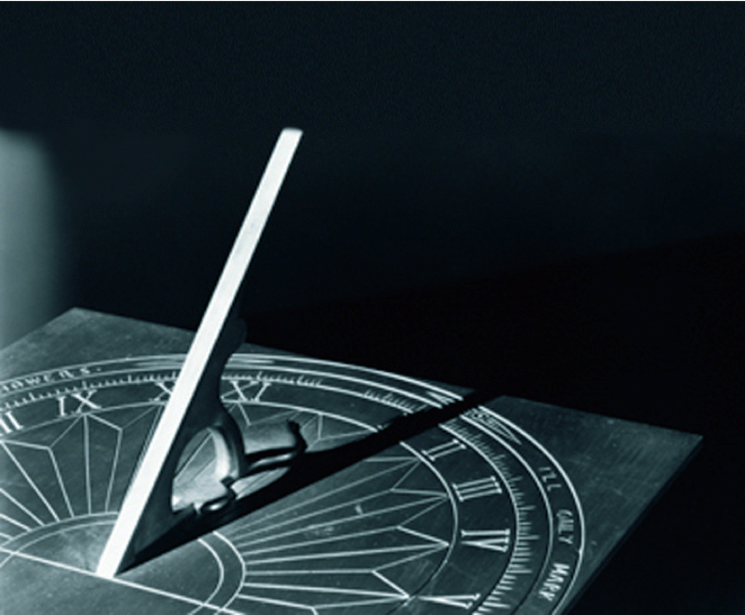
Earth and Space Science
constructing sundials and investigating how they work
Notes:
Why learn this?:
Learning about sundials gives us a better understanding of the sun as a source of light. Students will gain an understanding of the characteristics of light, and learn how it can be used to tell the time. Learning about sundials will give student a solid base to work from in future units of work.
When do we learn this?:
We will cover this sub strand in second term, following a unit of work on:
recognising the sun as a source of light
We then go on to units of work on:
describing timescales for the rotation of the Earth
modelling the relative sizes and movement of the sun, Earth and moon
We can use ‘scientific inquiry method’ to investigate how the sun helps us tell time.
Ask a question {how do shadows work?}
Do background research {experiment with shadows}
Construct a hypothesis {the shadow of a still object moves consistently throughout the day, so we can use it to tell the time}
Test/retest hypothesis {mark the path of a shadow over the course of a day}
Analyse data {does the shape and angle of the object which casts the shadow effect the accuracy of the sundial?}
Report findings {write a report on sundials with diagrams using information from our TWLH chart}
In order to do this in class, we will experiment with light and shadow, using ideas from the Smithsonian Institute’s book ‘Eyes on the sky, feet on the ground’ (http://hea-www.harvard.edu/ECT/the_book/Chap1/Chapter1.html)

Slide 16
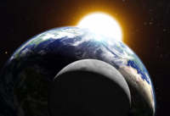
Common misconceptions children have about light and shadow  A shadow is something that exists on its own.  Light pushes the shadow away from the object to a wall, the ground, or other surface where the shadow lies
Light and shadow
Notes:
The curriculum states that students need to learn about light and shadow by constructing a sundial and learning how they work.
Sometimes children figure out their own explanations as to why things are the way they are (Chi, 2009; Philips, 1991).
I need to make sure that I know any misconceptions are, so as we work through the unit, I can focus on giving every student a solid base to work from.
I will ask the students if they are willing to change their minds about what they ‘know’ if they make a discovery which gives them new information (Abruscato, 2004).
We will create a TWLH chart, to record our learning journey

Slide 17
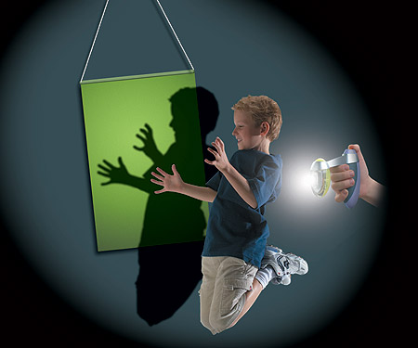
➲ Light travels very fast in straight lines until it strikes an object  Shadows result when an object blocks the passage of light  A shadow of an object will move due to either the motion of the object or of the light source  Even seemingly transparent objects can form shadows if they absorb or reflect some of the light striking them
What do students need to know?
Activity 1 making shadows
Notes:
Possible questions to consider and discuss:
What makes a shadow?
Do different kinds of objects make different kinds of shadows?
Are shadows different colours?
What makes a shadow disappear?
What makes shadows at night?
Do you have a shadow at noon?
Where is the Sun at noon?
Does a shadow cast by a still object move throughout the day?
Students make shadows with objects and themselves. Place a marble on the ground; ask students to make a shadow ring with their fingers around it.
What happens if they move their object closer/father from the ground?
Students draw around their shadows with chalk (can they draw their own?)
Make shadow with hula hoop-what happens when you change the angle?
Record the objects and draw the shapes made by the shadow
Discuss:
What causes shadows to form?
Was it easy or difficult to draw your own shadow?
What happened to the shadow as you moved your hand closer or farther from the ground.
Did the students notice that the shadows of objects farther from the ground are fuzzier than those cast by an object near to the ground - discuss effect called ’diffraction,’ evidence that light travels as waves.

Slide 18
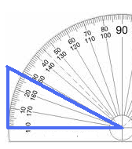
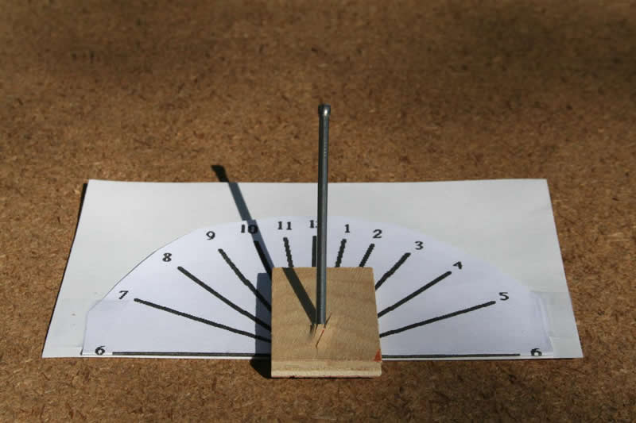
➲ the highest point of the gnomon (the part that casts a shadow) must point towards true South  The gnomon must be aligned with the Earth's axis of to tell the correct time  Once the gnomon is properly aligned, the shadow position can be marked each hour to make a clock which tells reasonable time
What do students need to know?
Activity 2 build a sundial
Notes:
Small groups: track shadow of a T-ball stand throughout a school day, marking with chalk at hourly intervals.
Discuss:
had the shadow travelled an equal distance at each marking interval? Why? (model the angle of the sun using a globe, a pencil and a torch to create shadows)
Materials: protractor, stiff card, scissors, sticky tape, marking pen
In small groups, make a 27.4° (the latitude of our Brisbane school, to align with the earths axis) angled cardboard wedge gnomon using a protractor. Use tape to stick the gnomon upright to a flat piece of card. At hourly intervals, mark a line where the top edges of the shadow falls on the flat part of the card. Record one full school day.
Discuss:
What would happen of we used a gnomon with a different angle? (test it out)
Had the shadow travelled an equal distance at each marking interval?
In which direction did the shadow appear to move?
Would the direction change if we were in the northern hemisphere? Why?

Slide 19
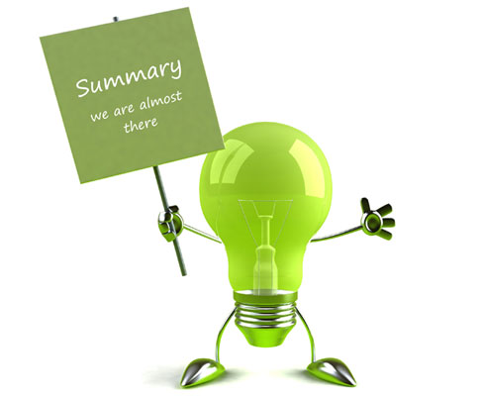
Summary
➲ How the curriculum documents translate
into learning experiences
➲ Scientific literacy is vital for decision making
➲ Science inquiry skills allow student to come to
reasonable conclusions
➲ Science can enhance other areas of the curriculum,
such as numeracy and literacy
➲ People do science- it is a human endeavour
Do science to know Science
Notes:
In this presentation, we have gone over {read points from screen} I hope you can now see the how what we do in class links to the curriculum, why it is so important for your child to learn science at school, as well as why it is taught in the way it is.
{draw the presentation to a close, answer questions}
Ladies and Gentlemen, thank you for attending my presentation on year three science for the 2012 year. I look forward to working with you to develop the students knowledge and understanding of science over the coming year.

Slide 20
-
References: (cont. in notes)
Abruscato, J. (2004). Constructing knowledge and discovering
meaning: How can I help children learn science?. In Teaching
children science: Discovery methods for the elementary and
middle grades (2nd ed., pp. 23-42). Boston, MASS:
Pearson/Allyn and Bacon.
ACARA (2010). Australian Curriculum: History. Retrieved on
5/12/2011 from http://www.australiancurriculum.edu.au/History/Curriculum/F-10?y=2&y=3&y=7&y=8&y=9&y=10&s=HKU&s=HS&layout=1
ACARA (2010). Content Structure. Retrieved on 27/11/2011 from http://www.australiancurriculum.edu.au/Science/Content-structure
ACARA (2011a). Science Rational. Retrieved on 23/11/2011 from
http://www.australiancurriculum.edu.au/Science/Rationale
ACARA, (2011b). General Capabilities. Retrieved on 25/11/2011 from
http://www.australiancurriculum.edu.au/GeneralCapabilities
Notes:
ACARA, (2011c). Science Aims. Retrieved on 25/11/2011 from http://www.australiancurriculum.edu.au/Science/Aims
Australian Curriculum Information Sheet (2011). A Curriculum for all Young Australians. Retrieved on 25/2011 from http://www.australiancurriculum.edu.au/Static/docs/Information%20Sheet%20A%20curriculum%20for%20all%20young%20Australians.pdf
Australian Education Council (994). A Statement of Science for Australian Schools. Melbourne: Curriculum Corporation
Amusable, D. (1968). The Acquisition and Retention of Knowledge. Educational Psychology, New York: Holt Rinehart &Winston
Buldu, M. (2007). Young children's perceptions of scientists: a preliminary study. Educational Research. 48(1)
Campbell, A. (2008). Science as a human endeavour. University of Waikato: New Zealand
Campfire band (2008). The gender agenda image. Retrieved on 30/11/2011 from http://campfireburning.files.wordpress.com/2011/08/woman-scientist-new-bedford-guide.jpg
Chi, M.T. (2009). Commonsense Conceptions of Emergent Processes: Why Some Misconceptions Are Robust. Journal of the Learning Sciences 14(2)
Department of Education, Employment and Workplace Relations (2009). Review of Funding for Schooling. Retrieved on 25/11/2011 from http://www.deewr.gov.au/Schooling/ReviewofFunding/Documents/SchoolStudents.pdf
Dreamtime (2011). Energy ball image. Retrieved on 15/11/2011 from http://www.dreamstime.com/energy-ball-image1892829
Factmonster (2010). School Years Around the World Image. Retrieved on 25/11/2011 from http://i.factmonster.com/images/australian-student.jpg
Hapkiewicz, A. (1992, June). Finding a List of Science Misconceptions. MSTA Newsletter, pp. 11-14
Hewson, P., Beeth, M. & Thorley, N. (1998). Teaching for Conceptual Change. International Handbook of Education. Great Britton: Kluwer Academic
Honours Earth and Space Science (2011). Dyes-Science-Space. Retrieved on 1/12/2011 from http://dyes-science.wikispaces.com/file/view/155854main_solar-system-montage-browse%5B1%5D.jpg/151983529/155854main_solar-system-montage-browse%5B1%5D.jpg
Hoon Kang, S. , Aizenberg, J., & Pokroy, B. (2010). Save our earth. Let's go green image. Science and the
Kiernan, K.E. & Mensah F.K. (2010). Poverty, family resources and children’s early educational attainment: the mediating role of parenting. British Educational Research Journal 37(2)
Lawrence, C. (1980). Science as a Human Endeavour. Medical History 24(4)
Macyk, Y. (2009). Night and day image. Retrieved on 2/12/2011 from http://01varvara.files.wordpress.com/2010/03/yuri-macyk-day-and-night-2009-e1270002862435.jpg?w=800&h=650
Magnificent Minds (2010). Explore image. Retrieved on 1/12/2011 from http://3.bp.blogspot.com/-XL-Vovg9uhc/TjfTYlvxYJI/AAAAAAAABvE/xYGv8A4n8sc/s1600/explore.jpg
National Science Foundation: International Science and Engineering Visualization Challenge image. Retrieved from http://www.nsf.gov/news/special_reports/scivis/
New South Wales Department of Education and Training (2010). Curriculum Structure Image. Retrieved on 28/11/2011 from http://www.curriculumsupport.education.nsw.gov.au/primary/scitech/national/images/struct.jpg
Phillips, W. P. (1991). Earth Science Misconceptions. Science Teacher 23(2)
Physical Science (n.d.). ball image. Retrieved on 30/11/2011 from http://www.nmsbvi.k12.nm.us/ATRC/Pictures/Balls.jpg
Qualter, A. Strang, J. Swatton, P. & Taylor, R. (1990). Exploration: A Way of Learning Science. Oxford: Blackwell Education
Scamp, K. (2011). Teaching Primary Science Constructively. 4th ed. South Melbourne: Cengage Learning
Schafersman, L. (1997). An Introduction to Science: Scientific Thinking and the Scientific Method. Miami University
Song of my heart (2010) backyard solar system image. Retrieved on 1/12/2011 from http://4.bp.blogspot.com/-ueBAOa_1AU8/TeR0coo-tcI/AAAAAAAACW4/Y_E_ww4ot0U/s1600/Solar+System+Outdoor+Model+006.JPG
Tree Hugger (2010). Earth day ideas for families image. Retrieved on 1/12/2011 from http://media.treehugger.com/assets/images/2011/10/20110422-earth-day-earth-hand.jpg
Websio (20011). Almost there image. Retrieved on 23/11/2011 from http://www.webseoanalytics.com/blog/wp-content/uploads/2010/09/summary-almost-there.jpg

