Slide 1
Digital Resource

Slide 2
IXL FOR THE LEFT AND RIGHT BRAIN
IXL offers visual representations, word problems and interactive activities. IXL provides an environment that rewards hard work. The multiple activities provide student with the opportunity to develop mathematically in a fun environment, but at the same time eliminate the opportunity of players guessing their way through. Instead students are encouraged to learn from their mistakes, and move through new challenges at students own pace.
IXL's maths skills are aligned to the 2010 Australian Curriculum, providing comprehensive coverage of math’s concepts and applications. With IXL's national curriculum alignments, teachers can easily find unlimited practice problems specifically tailored to each learning objective. There is how ever a cost that comes with this resources. For individual students the cost is $79.00 per year, or alternatively, for a class cover including 25 students the cost drops to only $199.00 per year.

Slide 3
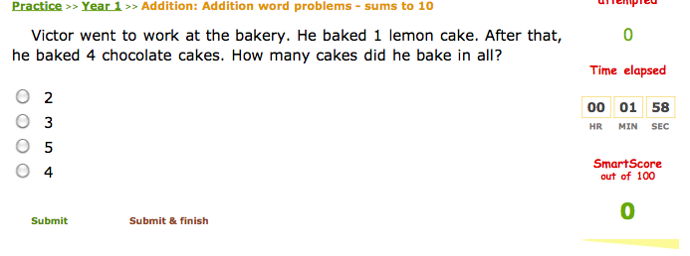
The Aim of the game
Regardless of year level or subject, the aim of the game is for students to slowly complete a treasure map, collecting hint’s to what steps to take next, once they have completed a particular task. Students reports are sent to the teacher/parent on request, that identify where the student is doing well, what they need assistance on, and what areas the student has neglected to attempt.
For the purpose of this assessment I have decided to present the addition word problems using numbers up to ten activity. This activity can be found with in the year one addition activities, or alternatively at : http://au.ixl.com/math/year-1/addition-word-problems-sums-to-10

Slide 4
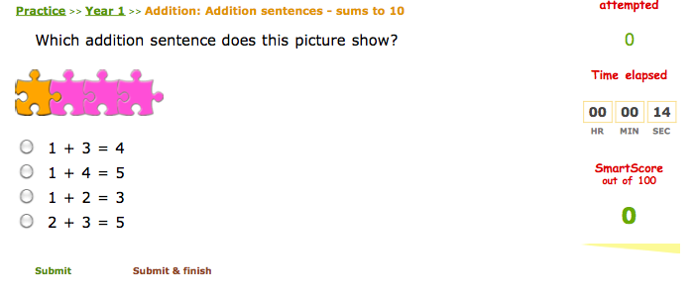
addition word problems using numbers up to ten activity, requires student to be able to read written number and have a sound ability to read. With this in mind there are activities that allow students to take part in the same activity but with symbolic and visual objects.

