Slide 1
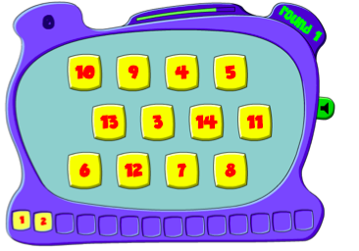
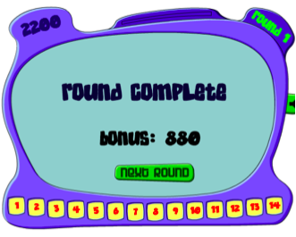
TheLearningPlanet.com
The Counting Game
Digital resources 2:

Slide 2
About the Game
Aim: In The Counting Game, the student is first asked for a number to count by, This can be between 1-9. The game then shows a set of numbers at the top of the screen and a number line along the bottom. The student must click on the next number in the series before the time runs out. As student progress through the levels the number patterns difficulty increases and the time limit decreases.
Students gain: The Counting Game is primarily focused on students practicing and reinforcing their concept, skills and strategies of cardinal numbers and number patterning. This game is only suited for students who are at the symbolic stage of the Language Model for Mathematics (Jamieson-Proctor, R. 2010).

Slide 3
Advantages and disadvantages
Advantages: The game presentation and aim is simple, but the sound effects of the time decreasing increase students anticipation. Students who receive a high score are recorded, thus there is a competitiveness to the game, which encourages students to continue to score more points then their last game. The point system allows students to recognise what areas they strive in when it comes to counting, as well as recognising number patterning that they are skilled in.
Disadvantages: The only disadvantage found in this game is in the setting up of the game. It encourages students to strive for high numbers to count by, to gain more points per level. In a classroom setting, this could significantly disadvantage some students, as it would separate the ability levels. In other mathematical games on the website, this concept is ok, how ever considering this game is based on gaining the most points, student who are unable to choose higher numbers could be out casted by their peers.

Slide 4
ALearningPlanet.com cost
AlearningPlanet cost $39.95 for a class of 30 students for 12 months. This includes individual student reports and access activity, along with an extra 200 game access. There is a 10 day free trial, however individually, this website can be accessed for free.
The Counting Game can be found at: http://www.learningplanet.com/subscribe/index.asp

