Slide 1
Digital Resources for Fractions

Slide 2
Aim of the Game!
The aim of the game is to compare the fractions and click on the one with the highest value. In the easy level you have four fractions to choose from, but in the harder level you have six fractions to choose from. The game is not on a time limit, but the aim of the game is to win the Dolphin race. Students do not have to choose the correct answer every time to win the race, but your Dolphin will begin to fall behind with incorrect answers.
This game is suitable for students at the symbolic stage of the language Model, who are practicing and reinforcing the concept of fractions.

Slide 3
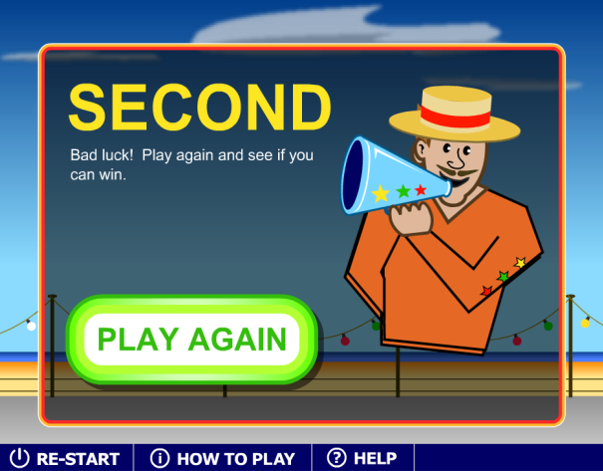
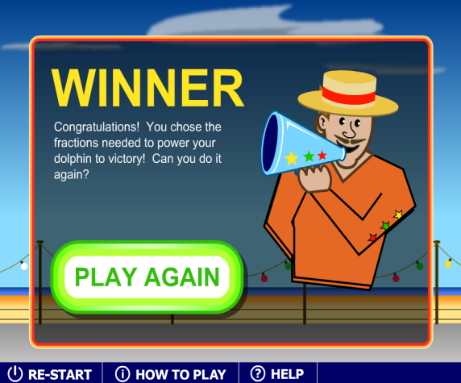
Advantages and disadvantages of the resources
Advantages: Although the game is set up as a race, students are not pressured to rush through the game as there is no time limit. At the end of the game, the students are placed as, 1st, 2nd, or 3rd, rather than win or lose, which a lot of other games have, this encourages the students to try again, rather than give up. The BBC website where the game is found, suggest to use the game on the smart board and use it as a whole class activity, this way students are able to learn from their peers as they justify their choice of fractions.
Disadvantages: The only disadvantage of the game that was found was that after three rounds of the game, similar fraction symbols appeared or repeated, thus after a while students could simply answer correctly through memory rather than using their own thought out concept. Although for this to happen, students would need to answer correctly in the first place. There is no link to the National Australian Curriculum, thus it would be the responsibility of the teacher to establish the appropriateness of the resources.

Slide 4
WHERE TO FIND THE gAME
Dolphin Racing is a free game that is found on the BBC Skill Wise + Maths website. The website is easy to navigate through and provides other curriculum games and resources for students, parents and teachers.
The dolphin game can be found at: http://www.bbc.co.uk/skillswise/game/ma17frac-game-dolphin-racing-fractions
Reference:
BBC (2011). BBC Skill Wise + Maths. Dolphin Racing . Retrieved August 27 2011. From: http://www.bbc.co.uk/skillswise/game/ma17frac-game-dolphin-racing-fractions

